Slide 1

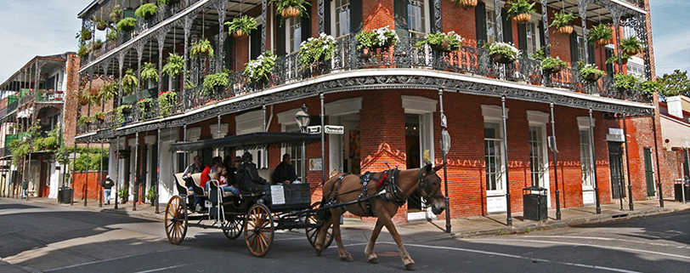

40th Annual Meeting
"Clinical Trials: A Catalyst for Societal Advancement through Innovation"
Sumithra J. Mandrekar
PRESIDENT’S WELCOME
Monday, May 20, 2019 New Orleans, Louisiana

Slide 2
International Clinical Trials Day
May 20, 2019
In 2005, International Clinical Trials Day was launched to commemorate the day when James Lind started his famous scurvy clinical trial on May 20, 1747.
This clinical trial laid the foundation for modern clinical trials research.
A perfect day to start our 40th Annual meeting!

Slide 3
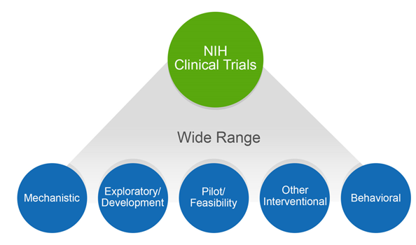
What is a Clinical Trial?
NIH Definition: A research study in which one or more human subjects are prospectively assigned to one or more interventions (which may include placebo or other control) to evaluate the effects of those interventions on health-related biomedical or behavioral outcomes.

Slide 4
What is a Clinical Trial?
Wikipedia Definition: Clinical trials are experiments or observations done in clinical research. Such prospective biomedical or behavioral research studies on human participants are designed to answer specific questions about:
  Biomedical or Behavioral interventions
    New treatments
      novel vaccines, drugs, dietary choices, dietary supplements, and medical devices
    Known interventions that warrant further study and comparison.

Slide 5
Who Are We?
A unique multidisciplinary society with membership spanning multiple disciplines that are all critical to the field of clinical trials, including:
  Biostatistics, Clinical, IT and Systems, Data management, Regulatory bodies, Protocol management, Patient advocates, Health outcomes researchers, Project Management and many others.

Slide 6
What is our Mission?
Work internationally to advance human health through advocating the use of clinical trials, leading the development and dissemination of optimal methods and practices in clinical trials, and educating and developing clinical trial professionals.

Slide 7
What is our Mission?
We accomplish our mission through:
Annual scientific meeting, which includes invited and contributed sessions, poster presentations, pre-conference workshops, and in-conference tutorials;
Our highly regarded journal Clinical Trials;
Our ongoing webinar series;
Our many outreach activities.

Slide 8
SCT’s 3-year Strategic Plan
Sustainability: Pursue Diversity in Membership
  Enhance outreach programs to increase membership
  Increase disciplinary diversity and re-build the representation of key disciplines that have been better represented in the past

Slide 9
SCT’s 3-year Strategic Plan
Leadership Development: Nurturing Society Leadership
  Identify early and mid-career individuals involved in the clinical trials enterprise who have the energy and potential for taking leadership roles in the Society
  Facilitate their appointment to meaningful roles within the Society

Slide 10
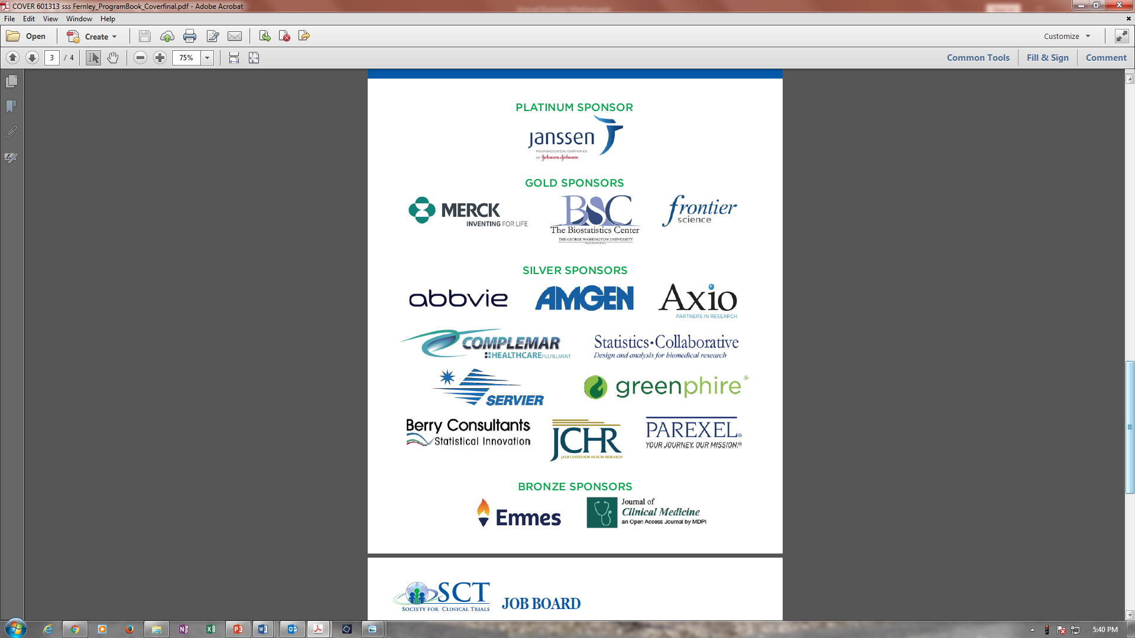
THANK YOU
2019 Corporate Sponsors

Slide 11
THANK YOU
2019 Corporate Sponsors

Slide 12
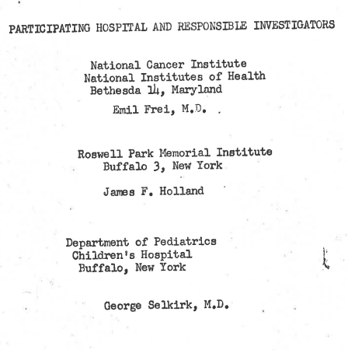
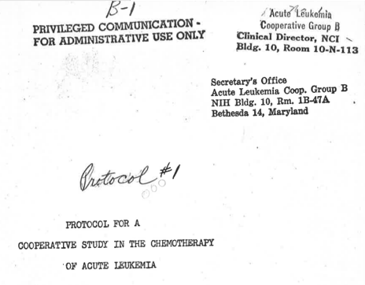
First multi-institutional randomized clinical trial
Slide Courtesy, Dr. Bertagnolli

Slide 13
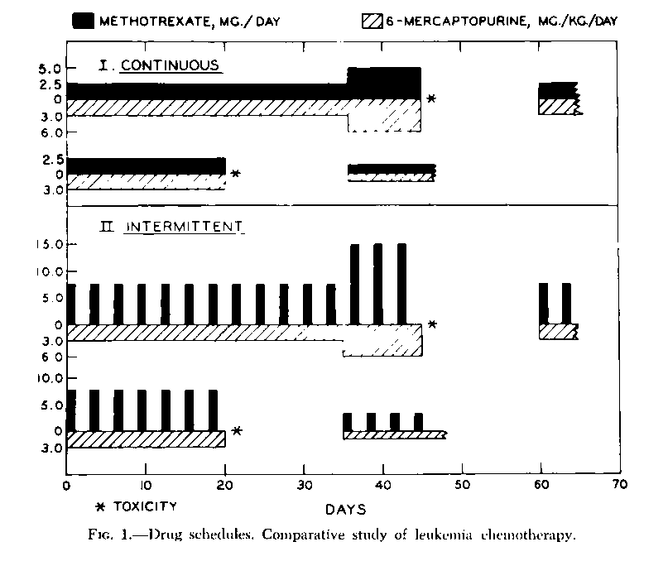
Protocol #1
Eligibility and Exclusion Criteria:
“an unequivocal diagnosis of acute leukemia”
Randomization plan:
“Sealed envelope technique”
Response criteria
Central morphology review
Anticipated toxicities
Recommended supportive care
Treatment plan
“Continuous or intermittent therapy with methotrexate (the variable) and 6-mercaptopurine (daily fixed dose); 35 days of treatment followed by the same drugs given at twice the dose for another 35 days, unless toxicity prevented dosage escalation”

Slide 14
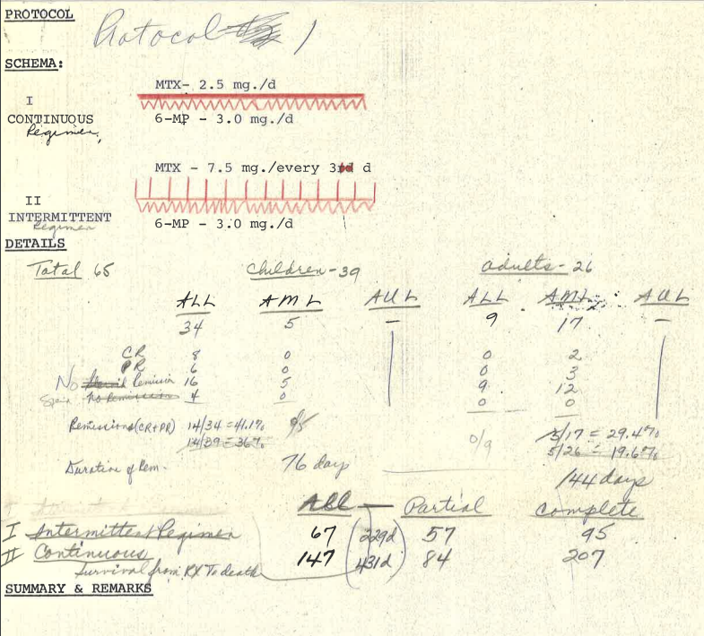
Flow Sheet for
Data Collection

Slide 15
AAML1031
AML <30 yr
MRD assessment end of induction I by flow
(but also testing molecular and genetic in parallel as pure correlative)
MRD >0.1% = escalate to high risk arm
AAML1031: A Phase III Randomized Trial for Patients with de novo AML using Bortezomib and Sorafenib for Patients with High Allelic Ratio FLT3/ITD

Slide 16
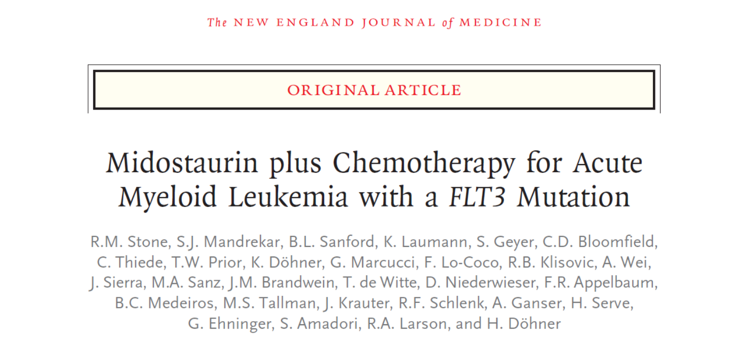
2017
FDA Approved April 2017
16

Slide 17
Schema
PRE-REGISTER
FLT3 SCREEN
R
A
N
D
O
M
I
Z
E
DNR
ARA-C
Midostaurin
CR
X 4
Midostaurin
MAINTENANCE
12 months
HidAC
Midostaurin
Stratify*
FLT3
ITD
or
TKD
DNR
ARA-C
Placebo
CR
HidAC
Placebo
X 4
Placebo
MAINTENANCE
12 months
FLT3 WILD TYPE not eligible for enrollment
Stratification: TKD; ITD with allelic ratio <0.7 ‘vs’ ≥0.7
17

Slide 18
Consort Diagram
Activated May 2008; completed accrual: Oct 2011
Screened 3,279 patients
Total FLT3(+): N=887 (27% of screened)
Total randomized: N=717 (81% of FLT3(+))
Midostaurin (MIDO) N=360
Placebo (PBO) N=357
Induction 1 N=355
Induction 1 N=354
Induction 2 N=81
Induction 2 N=101
Consolidation N=231
Consolidation N=210
Maintenance N=120
Maintenance N=85
18

Slide 19
Revised Analysis Plan
Event rate reached a plateau: 6 events 2014, 3 in 2015.
509 events predicted to occur in 2025
  Higher than expected transplant rate: 25% in CR 1,
  57% overall
  increased TKD incidence: 23%
  Median follow-up time for survivors: 56.7 mo (range: 0.1, 79.2 mo)
Alliance DSMB and CTEP approved the primary analysis of OS to occur with a cut off of April 1, 2015 with 357 events
19

Slide 20
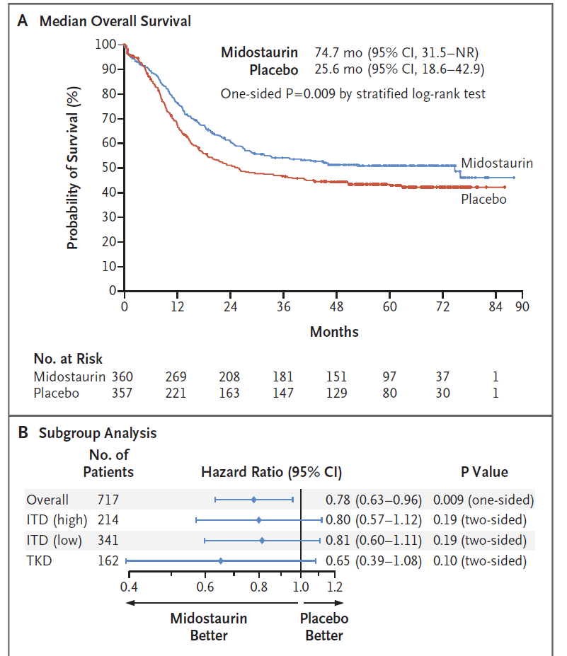
Overall Survival (Primary Endpoint)
24.3% reduced risk of death in the Mido arm
20

Slide 21
Desmoid tumor
Voluntary Biopsies at baseline and day 8
R
2:1
Sorafenib 400 mg daily
Placebo
CT or MRI scans every 2 months
Decrease in size or stable
Increase in size
UNBLIND
Stay on sorafenib or placebo
If progression
If on placebo, then switch to sorafenib.
If on sorafenib, then off study
UNBLIND
Gounder et al. , NEJM 2018

Slide 22
Trial Considerations: Rare tumor setting
Single arm or randomized?
What is the comparator arm? Implications on sample size/accrual/cost.
Is placebo ethical?
What should the dose of sorafenib be? 400 mg QD or BID? How long?
What is the primary endpoint for drug approval?
  Response rate? PFS?
  Patient reported Outcomes?
If using QOL/PRO, then blinding is critical, but is blinding truly possible?
Slide Courtesy, Dr. Gounder

Slide 23
Study Monitoring
A pre-specified interim futility analysis was conducted at 25 PFS events.
  DSMB requested an efficacy analysis, at its next session (6 months).
Efficacy analysis with 27 PFS events and 75 evaluable patients.
  Overwhelmingly positive data!!!!
  DSMB requested that all patients and clinicians be unblinded and placebo patients given the option to get open-label sorafenib.
Slide Courtesy, Dr. Gounder
Notes:
This is here to explain why the analysis was done prior to the 52 required PFS events

Slide 24
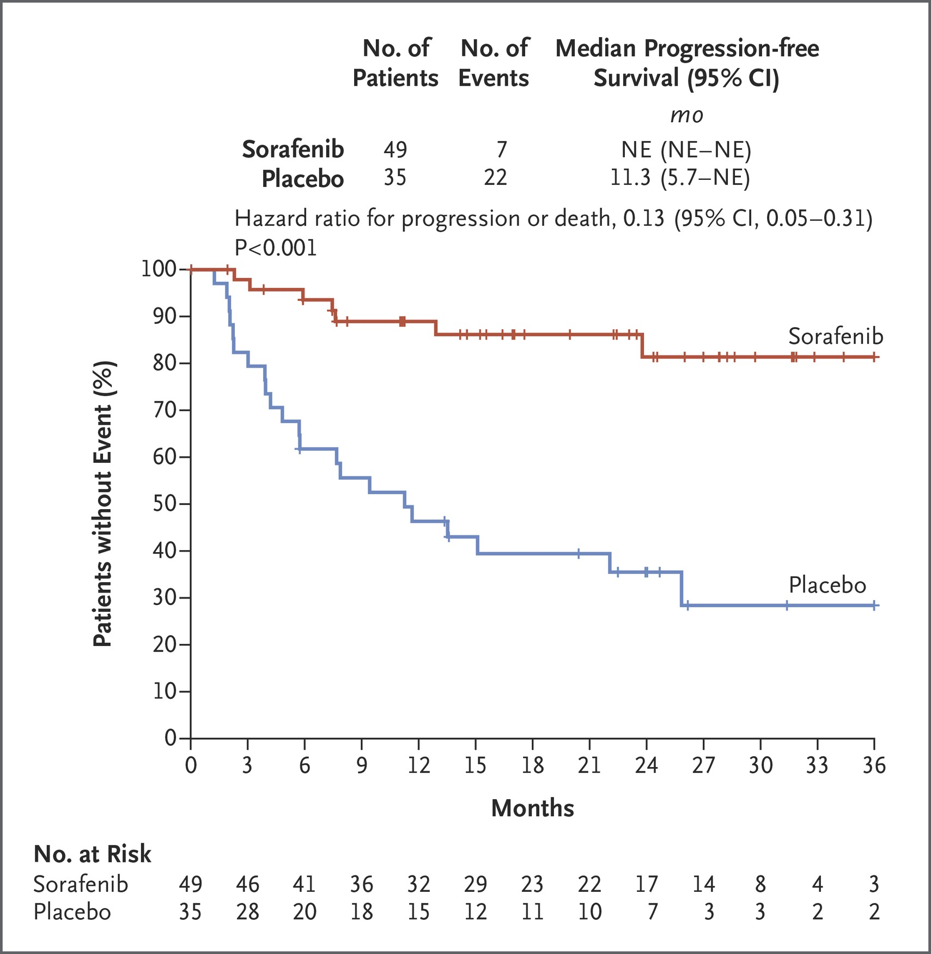
Progression-free survival at median of 27.2 months ~ 7 fold reduction in PFS or death
Undergoing
Consideration
for FDA filing
--based on data from 84 patients
Gounder MM, Mahoney M et al. N Engl J Med 2018
Slide Courtesy, Dr. Gounder
Notes:
Figure 2 Kaplan–Meier Estimates of the Duration of Progression-free Survival at the Time of the Last Assessment. Response Evaluation Criteria in Solid Tumors (RECIST), version 1.1, were used by the investigators to identify disease progression. Data from patients who did not have progression or who had died were censored and marked by a tick. NE denotes not estimable.

Slide 25
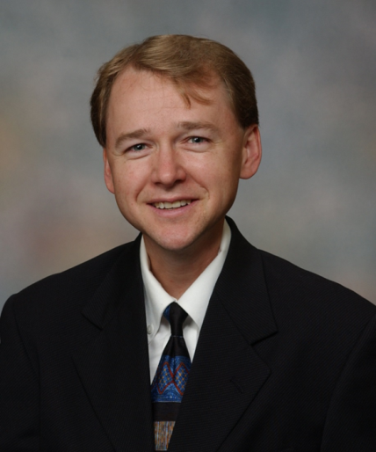
Remembering Dan Sargent
SCT President 2013-2014
Internationally recognized cancer biostatistician and leader in clinical trial design, endpoints and trial methodology (1970-2016)

Slide 26
Remembering Dan Sargent
Adjuvant Colon Cancer
OS: ultimate goal of any therapy for
life-threatening disease, but…
  Insensitive
  True treatment benefit may be confounded by successive lines of therapy
85% of deaths within 8 years of diagnosis are following recurrence (Sargent et al, NEJM 2001)
To meaningfully increase likelihood of cure, we must prevent recurrent disease

Slide 27
Colon Cancer: Hypothesis
DFS, assessed after 3 years, is an appropriate endpoint to replace OS in adjuvant colon trials
  Would allow more rapid completion, reporting of trials
  Allow promising agents to benefit patients more quickly
Methods: Data from large randomized trials
  Individual patient data from all trials
  Compare DFS, OS for each arm
  Landmark: 5 year OS

Slide 28
ACC Meta-Analysis: Trials Included
No Treatment Control
Active Control
Trial
N
Trial
N
N784852
247
NSABP C03
1081
INT 0035
926
NSABP C04
2151
N874651
408
NSABP C05
2176
Siena
239
N894651
915
NCIC
359
N914653
878
FFCD
259
SWOG 9415
1078
NSABP C01
773
INT 0089
3547
NSABP C02
718
GERCOR
905
GIVIO
867
QUASAR
3517
Total: 43 treatment arms; 20,898 pts

Slide 29
Adjuvant Colon Cancer: 3 yr DFS vs 5 yr OS
1.3
R
2
=0.90
1.2
1.1
1
Overall Survival Hazard Ratio
0.9
0.8
0.7
Sargent, JCO 2005
0.6
0.5
0.5
0.6
0.7
0.8
0.9
1
1.1
1.2
1.3
Disease Free Survival Hazard Ratio

Slide 30
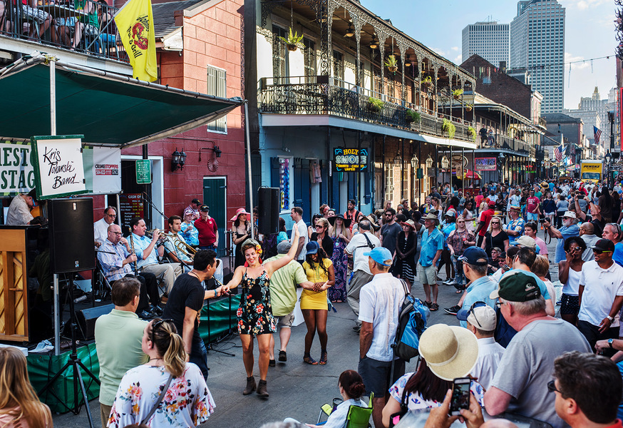
Let’s Celebrate the 40th birthday of SCT! Dessert Reception with DJ and Dancing
Monday, May 20, 9 pm – Midnight
Armstrong Room, 8th Floor

Slide 31
Round Table Sessions
Monday during Lunch
SPECIAL Founder’s Session
Tuesday, May 21, 5-6:30 pm
Napoleon BC, 3rd Floor

Slide 32
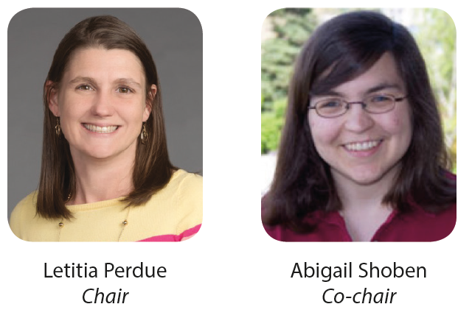
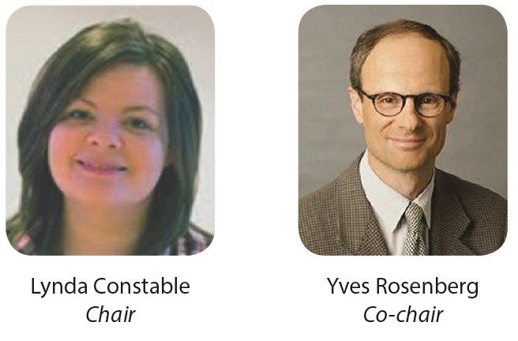
2019 Program Chairs
2019 Education Committee Chairs

Slide 33
Conference Registration Totals
May 17, 2019
Total number of registered attendees: 582.
Pre-conference workshop registration: 153.
In-conference tutorials registration: 82.
Largest meeting ever!!!

